Slide 1
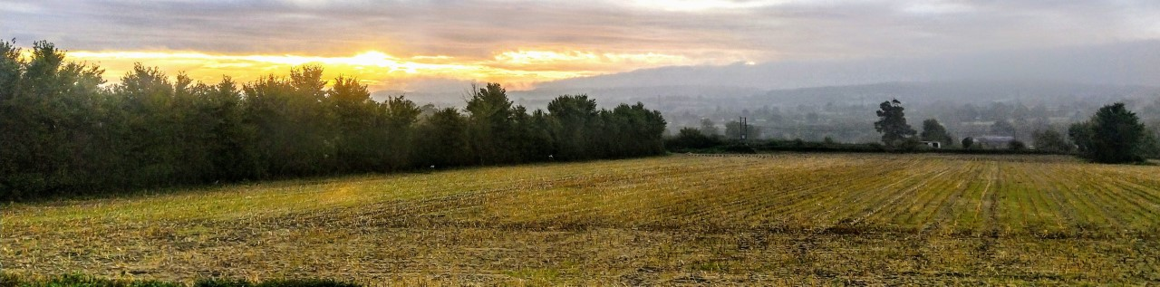
Friends of Little Keyford (F.O.L.K)
Objections
Proposed development of land at FR3A:
2020/0451/FUL | Full Application AMENDED (Wainhomes)
2020/0341/OTS | Outline Application (BDW)
2019/3076/FUL| Full Application (BDW)

Slide 2
Objections
The three proposals in question have raised considerable concerns among the local community.
Attention must be paid to the level of objections in the public comments:
  N.B. the numbers objecting will only increase toward the consultation deadline.
  The single supporting comment for 2020/0341/OTS was from the director of a construction company.
In particular, substantial objection from the local community regarding the creation of any access from Little Keyford Lane.
 | Comments | Objecting | Supporting
2020/0451/FUL | 68 | 64 | 0
2020/0341/OTS | 71 | 69 | 1
2019/3076/FUL | 88 | 83 | 0

Slide 3
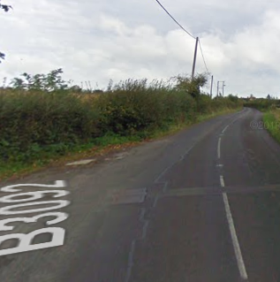
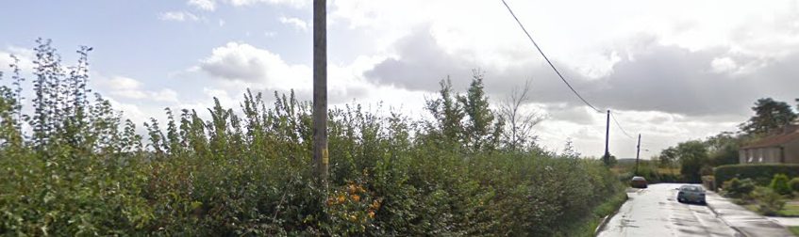
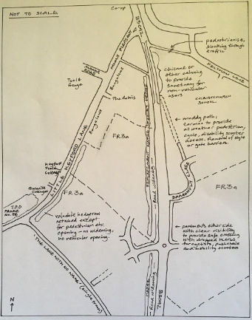
Access
It is obvious to all – including the Landscape & Visual and Highways Statutory Consultees – that access should be from the established main road into Frome (B3092).
A suggested plan that included a roundabout was put forward by F.O.L.K.
The hedgerow along Little Keyford Lane must be kept intact and complete – particularly for ecology.
There is significant amenity use of Little Keyford Lane, which has only increased during recent times due to the pandemic.
Highways England have recommended holding any decision until the broader impacts can be understood to the area.

Slide 4
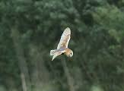
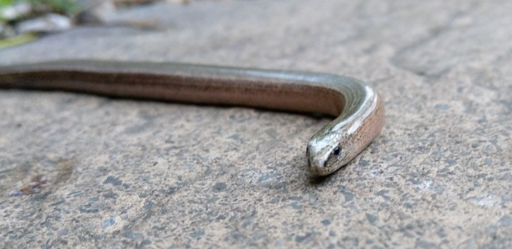
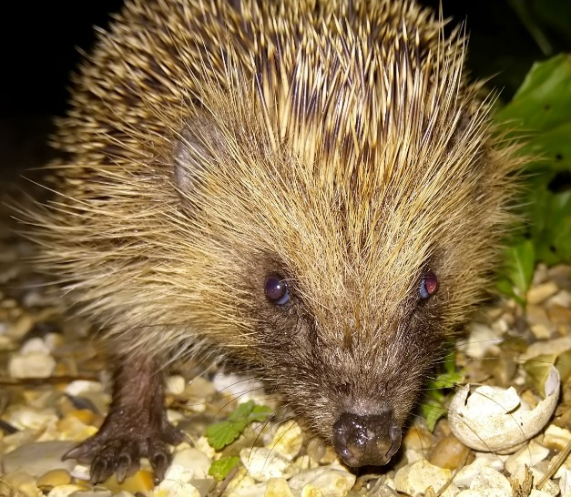
Ecology
MDC stated in Policy FR3a that any development of FR3a is to "…provide enhancement for biodiversity (in line with Government policy) ensuring that habitat connectivity is maintained through the site and with the wider countryside".
  There is no evidence of this and both the MDC ecologist and Natural England are very critical and do not support the applications in their current form.
  There is a net deficit of replacement habitat in the Wainhomes proposed development (2020/0451/FUL) and even more inadequate if FR3a is placed in Band B of Mells SAC due to evidence of a nearby greater horseshoe bat roosts (thereby requiring more replacement habitat).
  Replacement habitat has been poorly planned and done in isolation for each of the FR3a areas – see later slide.
There is a diverse range of flora and fauna within FR3a, including two barn owl roosts (and possible nesting) – no seasonal surveys have been completed. This was not known by MDC when they included FR3a in the emerging LPP2 (despite being pointed out by FOLK).
Protected reptiles are present in the area including slow worms and anecdotal evidence of great crested newts.
Some of the rarest bats in the UK have been reported within FR3a at activity of regional / national importance. However, no cohesive survey has been completed for FR3a and the surrounding are (see next slide).
There is badger activity in FR3a – not acknowledged by recent reports, but observed locally and report to FTC in a report for FR007.
Barn owls which roost in
2019/3076/FUL and 2020/0451/FUL
Slow worm – Gurnville Cottages 2020
Hedgehog – Gurnville Cottages 2020
Some of the fauna of FR3a /
Little Keyford Lane

Slide 5
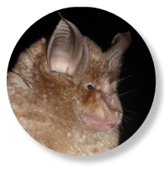
Greater Horseshoe Bats
Natural England state the current proposed development of FR3a could have significant effects on the Mells Valley Special Area of Conservation (SAC).
Bat survey data submitted by Wainhomes and DWH indicates the presence of a previously unknown nearby roost (closer than Mells SAC) and that the FR3a site should at fall into Band B of the SAC (at minimum more replacement habitat required).
Greater Horseshoe Bats present at Regional and National levels of importance based on the bat survey data submitted by Wainhomes and DWH. Once the greenfield sites have gone and foraging areas have gone, they are gone forever.
There have been no cohesive bat surveys. Separate reports for each application, by different ecologists, using different equipment and completed at different periods, with notable gaps in peak survey periods. Questionable surveys within the Wainhomes area have been identified (as commented upon by MDC and Natural England).
Replacement habitat is in the wrong place. Convenient for the development around down gradient attenuation ponds, but not targeted for its purpose – i.e. replacement habitat should be positioned in the right place, such as areas of high bat activity and designed to provide joined-up commuting corridors and foraging area without light pollution from street lighting, cars and housing (particularly important for light sensitive greater horseshoe bats and other light sensitive species present here).
Hedgerows must be maintained without breaks for roadways. Primarily those along Little Keyford Lane and the unnamed lane to the south.
Net deficit in replacement habitat within the Wainhomes area (2020/0451/FUL).
Other rare bat species have been recorded – not just greater horseshoe bats.

Slide 6
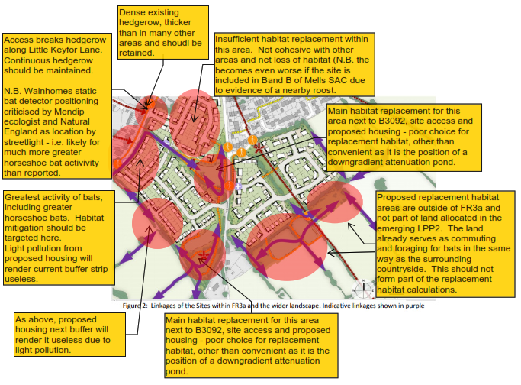
Poorly Planned Habitat Mitigation
Inadequate BDW / Wainhomes proposed habitat / linkage plan annotated by FOLK
N.B. There is no evidence of a cohesive masterplanned approach between the FR3a areas. Separate bat surveys have been submitted, from different ecologists, using different equipment and undertaken at different times. There are also notable gaps in optimal survey time.
N.B. There has been focus on greater horseshoe bats due to the Special Area of Conservation (SAC), but there are also other of the rarest bats that have been recorded here including the lesser horseshoe and barbastelle.

Slide 7
Greater Horseshoe Bats (cont.)
The Somerset Bats Action Plan states:
  “Road mortality - bats are affected by road mortality. Lesser Horseshoe and Whiskered bats often fly 0.5-3 metres above road level across 20-40 metre gaps in hedgerows where they have been created by a road scheme. One road scheme in North Wales is reporting the loss of two Lesser Horseshoe bats per night resulting in mitigation costs of over £1 million that could have been avoided if considered at the design stage”.
  This clearly highlights the impact of the increased vehicle movement associated with the proposed allocations and the likely significant impact that this would have to bats.
Loss or fragmentation of flight lines could threaten the viability of a colony, including those several kilometres away from a development. There are known nearby colonies of greater horseshoe bats in both Mells to the west and in West Wiltshire at a similar distance to the east.
We stated in our consultation response to MDC that there are likely to be further winter and summer / maternity roosts within the general area that will be impacted by the loss of this land – this has been substantiated by the recent ecological reports that have been submitted.
More data is needed before any development can be allowed to proceed, which must be cohesive for the whole of FR3a and the surrounding area (as noted by Natural England).
Consideration should be given to rejecting any development here.

Slide 8
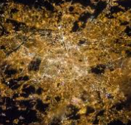
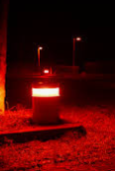
Lighting
There is no cohesive lighting plan for FR3a and conflicting information in the Wainhomes and BDW applications that would render much of the replacement habitat useless and redundant.
Natural England are very critical and state that they cannot approve the applications in their current form.
The highest concentration of bats (including Greater Horseshoe Bats) is adjacent to Little Keyford Lane and the unnamed lane to the south, suggesting commuting linkage to the surrounding hedgerows – minimal lighting should be targeted to these areas.
Lighting should be designed to provide joined-up commuting corridors and foraging area without light pollution from street lighting, cars and housing (particularly important for light sensitive greater horseshoe bats and other light sensitive species present here).
The Somerset Bats Action Plan states:
  “Artificial lighting can also affect the commuting and feeding behaviour of bats. Studies have shown that, although some species of bat swarm and feed around white mercury streetlights, others, such as Rhinolophus, Plecotus and Myotis species, will avoid artificial lighting. Street lighting can therefore cause habitat fragmentation and prevent bats from reaching feeding areas. Street lighting will also draw prey away from feeding areas that would otherwise be available to species averse to artificial lighting and would prevent safe exit from roost sites”.

Slide 9
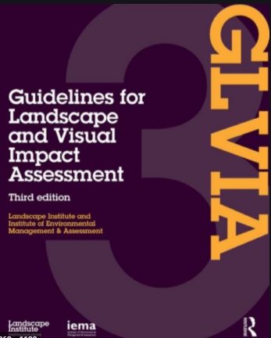
Landscape and Visual
Photo of 2020/0341/OTS
MDC’s current evidence base for this area states:
  “On the southern side and northwards as far as The Mount, the former open field landscape is attractive and only locally affected by the build edge. Further expansion of development southwards down the slope would intrude into the rural character of this area, which, within its easy access from the town, has significant amenity potential. Indeed, the existing hedgerow framework would be a basis for additional planting to mitigate the effects of the present intrusive edges. New development here… would therefore be inappropriate”.
The MDC Landscape & ​Visual Statutory Consultees states that separate plans are unacceptable in their current form and that there are major adverse impacts to both the landscape and the visual setting. The author is strongly against access from Little Keyford Lane, or for losing any of the hedgerow along the lane.
The area of FR3a is visible from significant distances, as far away as Chapmanslade, Cley Hill and King Alfred’s Tower – views of the town from without do matter a great deal, as acknowledged by MDC’s evidence base.
Many other views of Frome are intimate and limited.

Slide 10
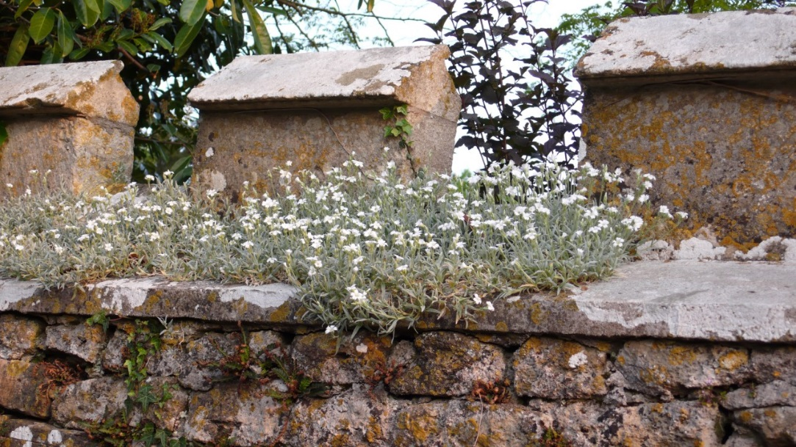
Archaeology and Heritage
Crenulations at Keyford House
No known archaeological investigations of the site have been completed on this greenfield site and there is evidence in the area of Roman activity and prehistoric settlements.
Recent archaeology work within 700m of FR3a found pre-Roman artefacts and it would be reasonable to anticipate similar finds on this site given its hill top location and southerly aspect.
The archaeological statutory consultee recommends that archaeological work should be undertaken.
Grade II listed Keyford House is an important historical landmark and heritage feature of the area along with its surroundings and nearby cottages most likely built to house workers
At minimum, an archaeological investigation comprising geophysics and evaluation trenches should be completed to understand whether the site is of archaeological importance and appropriate measures taken before any development is permitted within FR3a.

Slide 11
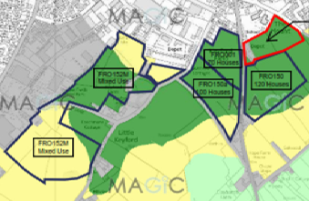
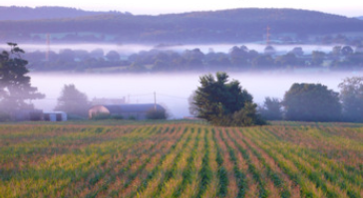
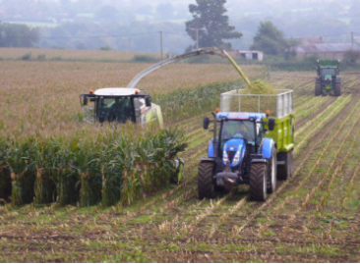
Agricultural Land
All of FR3a is Best and Most Versatile (BMV) land.
The cumulative impacts of losing >20ha of BMV land across the south of Frome from recent and proposed developments have not been addressed, despite the importance of such land being recognised by the National Planning Policy Framework (NPPF) and also by Natural England.
Dark Green = Best and Most Versatile (BMV) Agricultural Land
Natural England describe BMV as the:
    “most flexible, productive and efficient in response to inputs and which can best deliver future crops for food and non food uses such as biomass, fibres and pharmaceuticals”.
BMV land needs protecting for future generations. Cumulative loss of >20ha of BMV is considered a significant effect in the context of Environmental Impact Assessment (EIA). Yet no mention of BMV land or any mitigation has been proposed.
The loss of such an area of BMV land should be avoided, and if not, at minimum should be mitigated with schemes such as clearly defined soil management procedures, preservation of soils and provision for replacement/improvement of land of lesser value.
We are not aware of any specific consultations regarding loss of BMV land with Natural England, which is a requirement of The Town and Country Planning (Development Management Procedure) (England) Order 2015 (UK Statutory Instruments 2015 No. 595. SCHEDULE 4 (y) (ii)), which should have been completed by MDC during the LPP2.
Photo of 2020/0341/OTS
Photo of 2020/0341/OTS

Slide 12
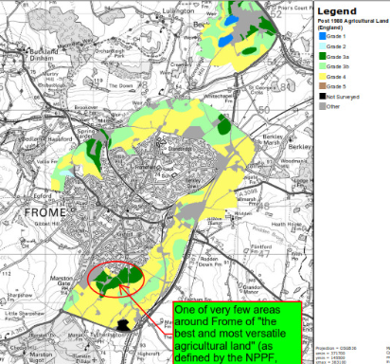
Agricultural Land
Agricultural Land - Legislation and Guidance: https://www.gov.uk/government/publications/agricultural-land-assess-proposals-for-development/guide-to-assessing-development-proposals-on-agricultural-land
Natural England - A Green Future: Our 25 Year Plan to improve the Environment 2018:
  protect the best agricultural land
  put a value on soils as part of our natural capital.
National Planning Policy Framework (NPPF) states that LPAs should use the NPPF to make decisions about the natural and local environment to:
  protect and enhance landscapes, biodiversity, geology and soils
  recognise soils as a natural capital asset that provide important ecosystem services
  consider the economic and other benefits of BMV agricultural land, and try to use areas of poorer quality land instead of higher
Town and Country Planning (Development Management Procedure (England) Order) (DMPO) 2015
  Planning authorities must consult Natural England on all non-agricultural applications that result in the loss of more than 20 hectares (ha) of BMV land if the land is not included in a development plan. For example, this includes the likely cumulative loss of BMV land from the proposed development if it’s part of a phased development.
  This is required by schedule 4(y) of the Order.
Planning Practice Guidance for the Natural Environment
  Paragraphs 001 and 002: Planning Practice Guidance for the Natural Environment explain why planning decisions should take account of the value of soils and agricultural land classification (ALC) to enable informed choices on the future use of agricultural land within the planning system.
The NPPF defines BMV as Grade 1-3a. All of FR3a is BMV land.
The cumulative impacts of proposed developments across the south of Frome total >20ha and the impact of losing this area of land is considered to be a “significant adverse effect”.

Slide 13
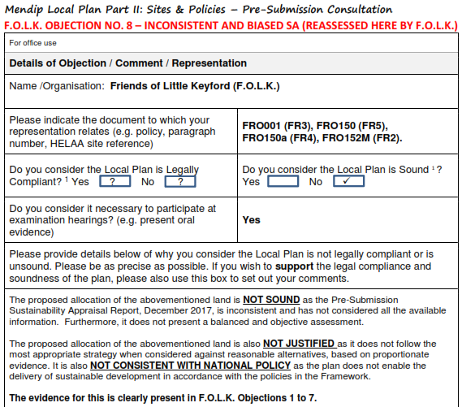
MDC Sustainability Appraisal
(and the Legitimacy of the Proposed Allocation)
FOLK reappraised the MDC Sustainability Appraisal as part of our consultation response to MDC. This highlighted the sensitivity of the land within FR3a. Evidence of this sensitivity has been substantiated by the recent reports submitted with the speculative FR3a planning applications.
The MDC Sustainability Appraisal incorrectly identified that this site scored poorly in several aspects – this has been proven to be incorrect
The scoring for SA05: “Protect, maintain and where possible enhance, the district’s native biodiversity” can be demonstrated to have an even greater negative impact than originally assessed by MDC.
Given the new factual information that is available, the MDC Sustainability Appraisal warrants a full re-assessment (not just based on ecology/biodiversity).
A significantly reduced score may warrant FR3a being removed from the Draft LPP2 and deferred to the forthcoming Local Plan review to be considered alongside other less sensitive sites if further development is demonstrated to be needed in Frome. Any other action could be considered as unsound and not legally compliant.

Slide 14
Cumulative Impacts
The cumulative impacts are perhaps the most important aspect for Frome Town Council, residents and the surrounding areas to consider – the proposed developments will cause a significant effect.
There is no consideration of the cumulative effects of adjacent developments with each other – not only FR3a, but also recent development such as Dragonfly Close and the imminent 12.5 hectare mixed-use development of FRO152M at Sandys Hill Lane (and other developments in Frome, including Saxonvale…).
There will be significant cumulative impacts which all need to be understood before any appropriate development can be permitted. This includes:
  Traffic and highways, Landscape, Amenity, Ecology, Flood Risk, Air Quality, Noise, Greenhouse Gases, Human Health, Historic environment.
Proposed, recent and “reasonably foreseeable” development exceeds thresholds for an Environmental Impact Assessment (previously not completed due to a technicality). F.O.L.K. will be writing again to the Secretary of State and MDC as there are now material changes.

Slide 15
Cumulative Impacts (cont.)
There is no consideration of biodiversity and habitat connectivity outside of each development area, not even within FR3a.
  MDC state in Policy FR3a that any development of FR3a is to "…provide enhancement for biodiversity (in line with Government policy) ensuring that habitat connectivity is maintained through the site and with the wider countryside".
  This is of particular importance with respect to rare species of bats.
There is no mention of how the loss of Best and Most Versatile (BMV) agricultural land will be mitigated.
  The cumulative impacts of losing >20ha of BMV land across the south of Frome from proposed developments that are coming through (of which this area forms part) have not been addressed, despite the importance of such land being recognised by the National Planning Policy Framework (NPPF) and also by Natural England.
  Natural England describe BMV as the “most flexible, productive and efficient in response to inputs and which can best deliver future crops for food and non food uses such as biomass, fibres and pharmaceuticals”.
  This land needs protecting for future generations and there can be no doubt that the loss of such an area of BMV land is significant and should be avoided (and if not avoided, at minimum should be mitigated with schemes such as clearly defined soil management procedures, preservation of soils and provision for replacement/improvement of land of lesser value).

Slide 16
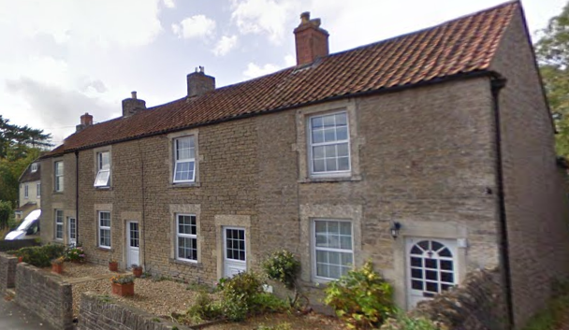
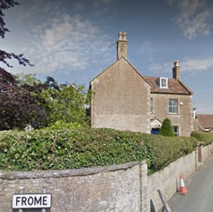
Local Vernacular
Frome has a distinct character (e.g. ‘Frome Ear’ windows) – new housing must not be allowed to “be influenced” by the nondescript ‘anywhere housing’ of Dragonfly Close.
The NPPF supports the value of ‘local distinctiveness’, ‘vernacular architecture’ and ‘local architectural precedents’.
Frome has many styles from different periods.
The aspiration in any new development of this scale must be to aim high, to reflect some of the best qualities and sustainable features to be found locally – not the cheapest construction and lowest denominator.
Gurnville Cottages

Slide 17
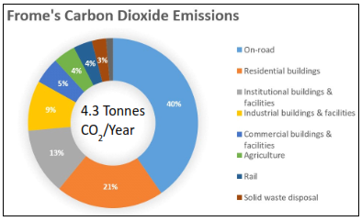
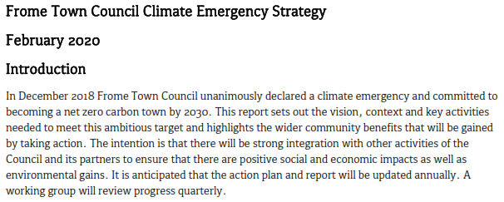
Climate
Emergency
FTC, MDC and Somerset County Council have declared a climate emergency.
Everyone needs to be held to account.
Frome is committed to becoming net zero by 2030 (only 9 years away).
The FTC Climate Emergency Strategy 2020 states:
  “Ensuring that planning stipulates zero carbon buildings and well-connected multi-functional green infrastructure, and the local plan embeds climate emergency into all strategies and policies is vital”.
  It is “important to ensure that new developments are built to minimise their impact and enable zero carbon lifestyles”.
  “Incorporate best practice design guidance into planning rules. Where zero carbon is not being achieved ensure developers pay per tonne of carbon emitted by the development to support and offset carbon reduction locally”.
  Develop a “Land Use Framework to optimise land for nature recovery, food growing, carbon storage and to a lesser extent ‘development’ would help to ensure land use is well planned and maximises climate benefits”.
Where development is permitted, it should be truly sustainable (e.g. Passivhaus standards, ground source heating, allotments and gardens, etc.).
BDW have developed eco-homes elsewhere (e.g. Hanham Hall), so why not here? There is a keen market for such housing.
Frome deserves better.

Slide 18
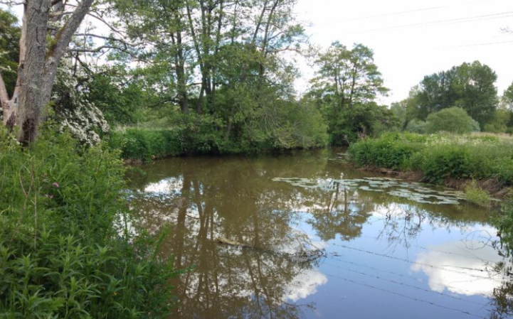
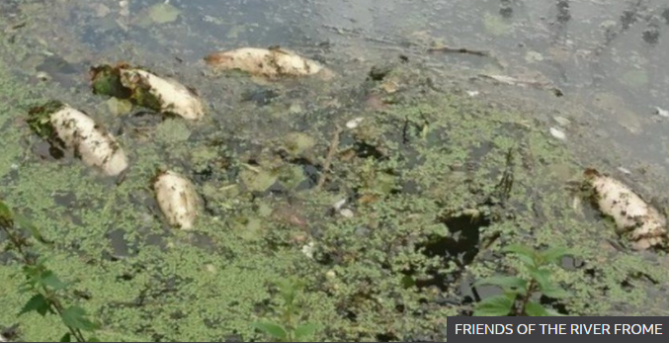
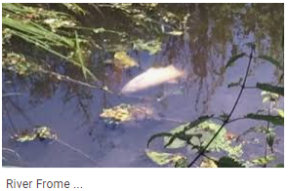
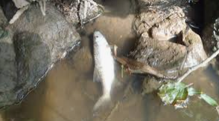
Surface Water and Flooding
Increased surface water run-off to the River Frome – see objections raised by Friends of the River Frome (FoRF).
The FoRF Strategy (2020 – 2030) has been adopted by FTC as a policy document. The strategy states:
  “The impact of climate change is becoming more visible as weather patterns change. Increased runoff, flood risk, soil and riverbank erosion are associated with higher and more prolonged rainfall with implications both for people and River wildlife. It is now widely agreed that mitigation to reduce these impacts in town and upstream in the rural catchment is an essential and urgent responsibility on those involved in land use and planning”.
There is no masterplanning for managing surface water from the three areas of FR3a.
Cumulative impacts from FR3a and other developments will be significant and the impact to the River Frome and downstream flooding has not been addressed.
Infiltration rates shown to be limited in some strata. Proposed attenuation ponds may be ineffective.
Attenuation ponds all located in the downgradient corner of each site. This does not offer the most sustainable solution for dealing with run-off compared to water management features through the FR3a and enhanced planting and creation of habitats.

Slide 19
Sustainability and Travel
Cumulative impacts of vehicle travel through Frome (e.g. to doctors and Secondary School) will result in adverse effects. This needs to be understood as air quality is already poor in places (e.g. St. Johns Primary School).
Little Keyford Lane has significant amenity use – this must not be lost and the proposed developments offer no measures to maintain or improve the amenity use. The proposed developments in their current form will cause significant adverse impact.
The option to close off Little Keyford Lane to traffic at the end of Gurnville Cottages has not been explored. This would:
  Prevent the lane becoming a “rat-run”.
  Protect the safety of amenity users (families, walkers, cyclists, horse riders etc.).
  Maintain hedgerows and commuting routes for bats, whilst also reducing potential road mortality due to traffic.
  Create a natural link to the wider countryside, to the stores at Marston Trading Estate and to the proposed pedestrianisation of Sandy’s Hill Lane.
  Stop trucks from following a sat-nav to Marston Trading Estate and becoming stuck on Little Keyford Lane.
No sustainable travel links into town have been proposed and no community improvements have been offered.
No measures have been incorporated in to the applications to address sustainability (in the true sense of the word) in line with commitments to address the Climate Emergency.

Slide 20
Reasons to reject the proposals
Do not consider any of the applications until the whole of FR3a has been adequately “Masterplanned”. The current applications should be REJECTED on this basis.
  Neither the emerging Local Plan Part II nor the overriding existing Local Plan Part I is being adhered to (the existing policy relies on the Landscape Assessment which states that development on the southern slopes of Frome would be inappropriate).
MDC’s ecologist says evidence suggests a nearby, previously unknown roost for Greater Horseshoe Bats – this increases the sensitivity of the site and should be investigated before these applications are considered.
  It puts the area of FR3a into at least Band B of Mells SAC and greater mitigation is required. This necessitates redesign of the poorly planned layout of FR3a. More information is needed and a full comprehensive study across FR3a and the surrounding area must be insisted upon.
The NPPF protects Best and Most Versatile Agricultural (BMV) land, yet there are no provisions or mitigation measures in any of the applications. The whole of FR3a is BMV land and the loss of this land this must be addressed.
  The cumulative impact of BMV loss is this part of Frome will be >20ha (significant adverse effect in the context of the The Town and Country Planning (Environmental Impact Assessment) Regulations 2017)).
A Climate Emergency has been declared at all tiers of government (regional, local and town). This approach must be defended during proposed developments to have any real impact.
  Appropriate design measures to meet carbon neutrality must be insisted upon. BDW have done this for other developments (e.g. Hanham Hall, Bristol), so they are capable of doing it here.
There is overwhelming public objection to the proposed development. The voice of Frome residents should not be ignored.
  The area of Little Keyford Lane has significant amenity use, which has been further highlighted during the pandemic. The consultation should respond to the concerns of residents who use the Lane.

Slide 21
Reasons to reject the proposals
Access issues have not been addressed. Instead of three separate entrances, all access should be from the B3092 main road.
  The reason for not doing this is inadequate. The scheme needs redesigning to include a roundabout and should not be considered in its current form.
Highways England has requested more information on impact to strategic junctions, which intimates there will be significant impact to Frome.
  Additional travel across town to services (e.g. Secondary School and Frome Medical Practice) must be addressed.
Cumulative impacts have not been addressed. These will be significant given c. 350 homes are to be built nearby at Sandys Hill Lane so we need an Environmental Impact Assessment.
  The cumulative impacts are significantly adverse in the context of The Town and Country Planning (Environmental Impact Assessment) Regulations 2017 and must be assessed accordingly. Whilst MDC’s initial screening for individual areas of FR3a did not assess it as necessary at the time, there have been material changes including developments that now have planning permission (e.g. Sandy’s Hill Lane), all three of the parts of FR3a coming through together, and the emerging policy FR3a.
The NPPF supports the value of ‘local distinctiveness’, ‘vernacular architecture’ and ‘local architectural precedents’. This has not been incorporated into the design.
  Off-the-peg buildings have been proposed, influenced by Dragonfly Close (incidentally, developed by BDW). The requirements of the NPPF must be addressed before any applications can be considered.
No seasonal studies have been completed regarding the reported barn owl roosts and possible nesting. This must be insisted upon.
There has been over a year of opportunity to address Statutory Consultee and public concerns and to masterplan the site – this has not been done. Only appropriate applications should be considered.
There are two full planning applications and one outline application on a site that is supposed to be ‘masterplanned’. If this is the extent of ‘joined up thinking’ between the developers then this alone should be reason to reject all three of these individual applications.
FROME DESERVES BETTER

